Slide 1
JAB Drum Board
By Alex von Fuchs, Brayden Daly, Justin Rosu

Slide 2
Presentation Outline
What is the JAB drum board?
What components did we use? / gen schematic
Hardware outline
What coding process did we do?
Demo
What didn’t work/ what could we improve in a V2

Slide 3
What is the JAB Drum Board
The JAB Drum board is a miniature DJ board with simple features including:
Playing a variety of sounds
Simple effects for each sound
Simple loops
Simple effects for the system

Slide 4
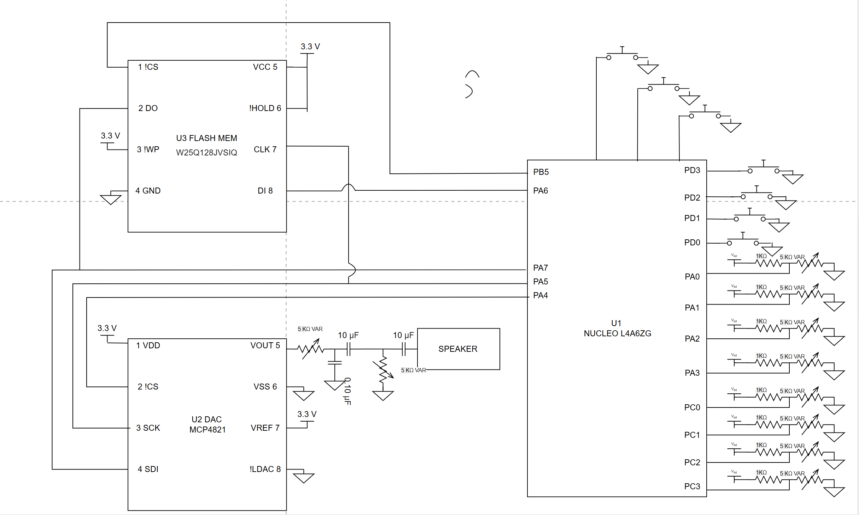
What components did we use?
128 MB FLASH MEM
12 bit DAC
Potentiometers & external button inputs
Adjustable Bandpass filter
Simple Audio driver circuit

Slide 5
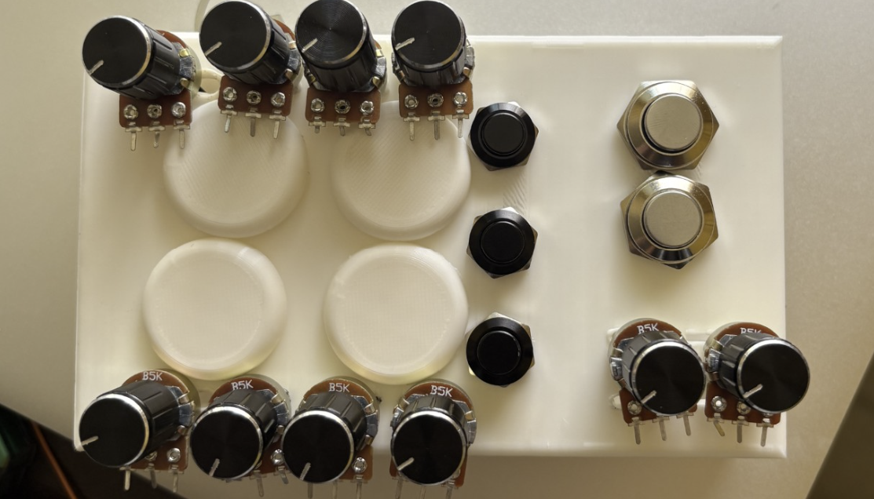

Slide 6
Generating Sound (Audio Driver)
Producing audio for stm32
Math behind ARR for 44.1kHz
AC Coupling
Superposition
Sound modes

Slide 7
Producing Audio
Find sound on garage band or other website
Import into audacity
Crop and export as mono 16 bit wave file
Use python script to map 16 bits to 12 bits and write to array
Put array into stm32 flash memory

Slide 8
Driving Audio
Interrupt based audio output
Desired playback rate: 44.1Khz (22.68 us)
Design Choice: 16 Mhz Clock
Ensured analog value output, not allowing time distortion
1
16MHz
22.68us
62.5 ns / tick
= 363 tick
= 62.5 ns / tick

Slide 9
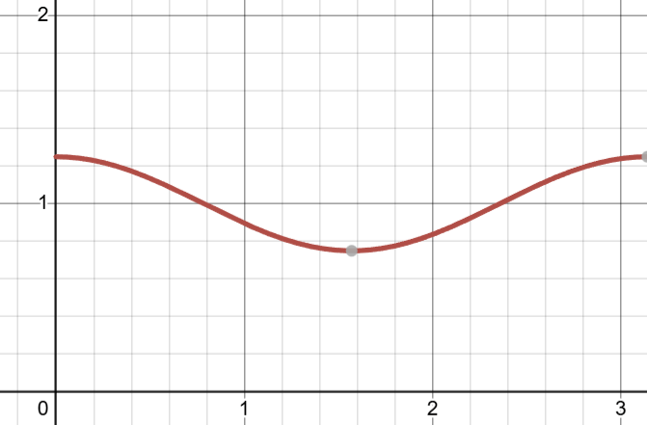
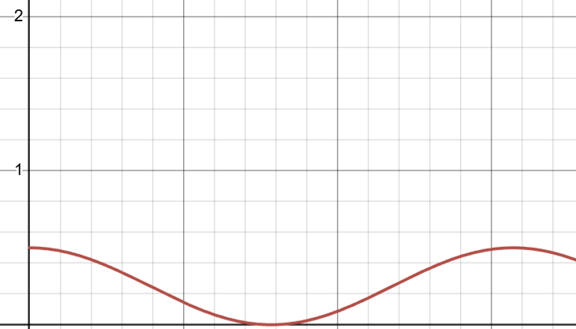
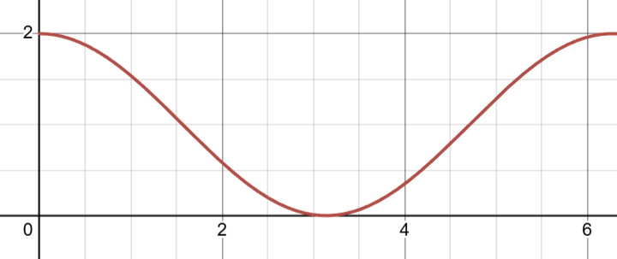
AC Coupling
Superposition
Standard AUX input 2Vpp, DC Offset = 0
Problem: DAC can't go negative
Solution: AC Coupling
Requires average to be held at 1V to be AC coupled
Sound has LTI property
Problem: Can't go over DAC limit (4095)
Solution: Normalize all audios by dividing and subtracting DC offset when audio playing

Slide 10
DEMO

Slide 11
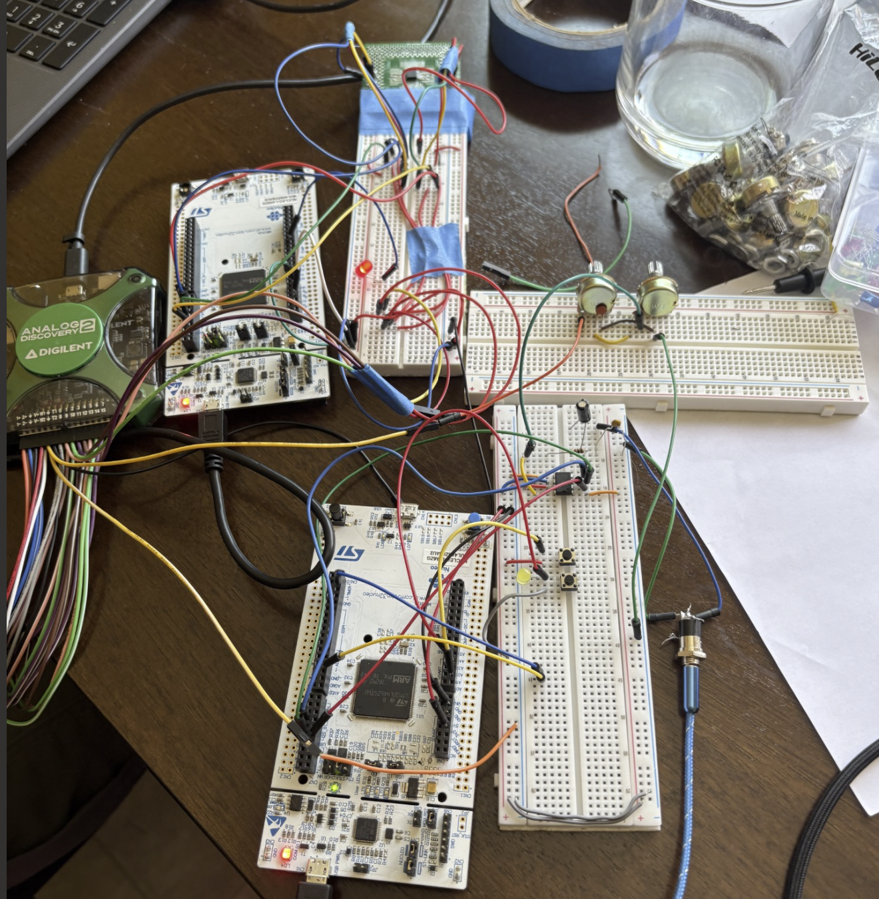

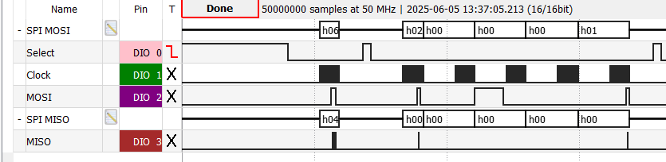
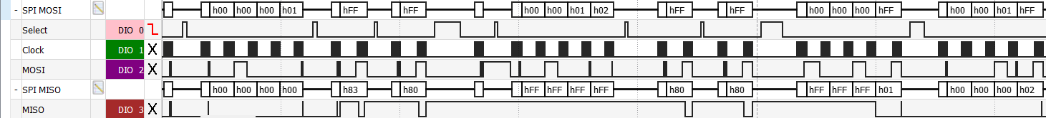
global_unlock();
erase_sector(addr);
uint8_t dataarr[2] ={0x1,0x2};
while (1) {
// Optional: Check if erase needed
for (int i = 0; i<2; i++)
{
write_byte(0x0+ i, dataarr[i]);
}
for (int i = 0; i<1; i++)
{
read_byte(0x0+ i);
}
uint8_t current = read_byte(0x1);
if (current == 0x2)
{
GPIOB->BSRR = GPIO_PIN_6;
}
else
{
GPIOB->BRR = GPIO_PIN_6;
}
Working with the W25Q128FW
https://www.google.com/imgres?q=stressed%20out%20emoji&imgurl=https%3A%2F%2Fcdn.vectorstock.com%2Fi%2F500p%2F68%2F92%2Ffurious-angry-face-emoticon-vector-876892.jpg&imgrefurl=https%3A%2F%2Fwww.vectorstock.com%2Froyalty-free-vectors%2Femoticon-stress-vectors&docid=gg-6Q1wP0KG14M&tbnid=x2Pvegq3r-6MQM&vet=12ahUKEwi959qIyNyNAxUtL0QIHdKCEHUQM3oECGcQAA..i&w=784&h=500&hcb=2&ved=2ahUKEwi959qIyNyNAxUtL0QIHdKCEHUQM3oECGcQAA

Slide 12
What didn’t work as intended
What worked
AC Coupled Speaker Circuit
Multiple Modes
Multiple sounds per mode
High Pass and Low Pass filters
Memory -> Loops
8 analog input-> pitch, gain

Slide 13
If we were to do a V2…
Plan ahead with hardware more,
Different sizes, better custom buttons, and pots
Use easier to implement memory
FFT’s / better DSP
Loops
Analog inputs

Slide 14
Thank you!

